Slide 1
Sexually Transmitted Diseases

Slide 3
How can I get an STD?
Many STDs are carried and transmitted through semen and vaginal fluids.
THE BIG 3
-Oral Sex
-Vaginal Sex
-Anal Sex
Some STDs can be spread through skin to skin contact
Mother to child

Slide 4
STDs: Signs and Symptoms
MEN | WOMEN
Groin Pain Burning during urination Milky discharge Irritation around opening of penis Testicular pain/swelling Sore Throat Anal Itching | Milky discharge Burning during urination Lower abdominal/back pains Nausea and Fever Painful intercourse Spotting between periods Sore throat/Anal Itch

Slide 5
STDs: Signs and Symptoms
MEN AND WOMEN
Groin Pain Sore Throat Anal Itching Nausea Fever *Most people infected with an STD have no idea that they are infected, but they can still pass it along to someone else.

Slide 6
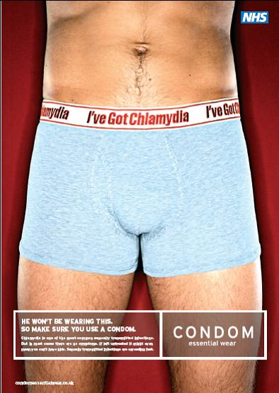
AVOIDING STDs
Abstinence!
Proper use of a latex condom
Form a monogamous
relationship in which both
partners are faithful to one
another get tested before
starting any sexual relations
Vaccination (Gardasil)

Slide 7
Curable or treatable….. That is the question…..
Only some STDs can be cured. Those that cannot be cured can only be treated.
Bacterial STDs can be cured with antibiotics and various prescription medications.
Viral STD infections are here to stay and can only be treated to lessen the symptoms.
More than ½ of the 19 million new STD’s each year come from 15-24 year olds.
(Center For Disease Control)

Slide 8
Chlamydia and Gonorrhea
Bacterial STDs (Curable with antibiotics)
Carried in semen and vaginal fluids
Transmitted through “THE BIG 3”
Can lead to sterility in both males and females
Tested for using visual inspection, urine sample and sometimes tissue sample (PAP Test)
AVOIDING Chlamydia and Gonorrhea
-Abstain from “The BIG 3”
-Correct latex condom use can lower chances

Slide 9
HPV: Human PapillomaVirus (Genital Warts)
Most common STD
6.2 million new cases develop in the United States each year (20+ million currently infected)
At least 50% of men and women will acquire an HPV infection in their lifetime.
More than 40 types of HPV, some are more severe than others.

Slide 10
What are the signs and symptoms? ***Most people with HPV develop no symptoms!***
Small bumps (warts) or groups of bumps in genital region (may appear weeks or months after contact)
*Don’t worry, the warts can be
frozen and/or burned off!*
Some types of HPV can cause cancer
**most common is cervical
cancer in females**
-less common is cancers of the
vagina,penis, rectum and anus

Slide 11
Diagnosing HPV
Usually by visual analysis during a physical examination
A sample of the abnormal tissue can be taken and sent to the lab for microscopic analysis
Cervical Cancer- early signs of cell changes in the cervix can be found using a routine pap test.

Slide 12
I wanna be the minority!
Abstinence is best!
FEMALE and MALE Vaccine (Gardasil)- can now protect females from 4 types of HPV that cause cervical cancer. Girls 11-26 years (Remember there are over 40 types of HPV)
Latex condoms may lower the rate of transmission if used correctly
Mutual monogamous relationships when both partners have been tested

Slide 13
Genital Herpes (Herpes Simplex Virus)
Herpes is a viral infection of the skin
HSV-1 causes a mouth and lip rash
HSV-2 causes genital herpes

Slide 14
Signs and Symptoms
Tender and swollen groin glands
water blisters (vesicles) or open sores (ulcer),
When sores are present, flu-like symptoms including headache, fever, and swollen glands
In women, sores can erupt in the vaginal area, external genitals, buttocks, anus or inside the cervix.
In men, sores can be on the penis, scrotum, buttocks, anus, thighs or inside the channel between the bladder and the penis (urethra).
Various factors may trigger later outbreaks, including Stress, menstruation, fatigue, illness, or surgery

Slide 15
How to get it…… How to avoid it…..
Transmitted through skin to skin contact of genitals and surrounding area
AVOIDING HERPES
Abstinence!
Correct condom use covering all skin contacts
*You can’t cure herpes, but you can treat the symptoms*

Slide 16
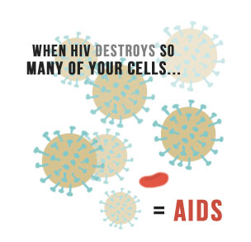
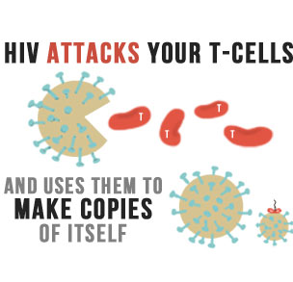
Human Immunodeficiency Virus (HIV)
Weakens the body’s immune system by destroying cells that fight disease.

Slide 17
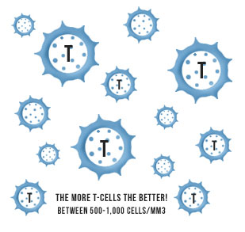
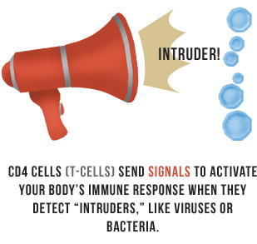
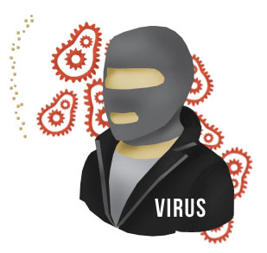
T-CELLS & The Immune System
T-Cells, are the “generals” of the immune system and send signals to activate the immune system when “intruders” (bacteria and viruses) are detected.

Slide 18
Acquired Immuno Deficiency Virus
Once HIV has destroyed enough of the body’s immune system, individual are classified as having A.I.D.S.
A.I.D.S. is the final stage of H.I.V.
*There is currently no cure for H.I.V./A.I.D.S.*
Treatments are available to help provide prolonged life. (VERY Expensive!)

Slide 19
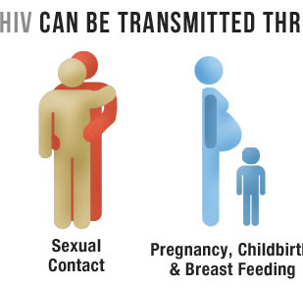
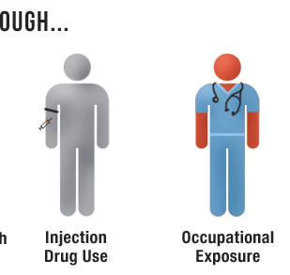
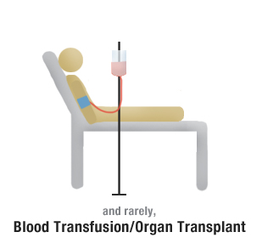
Transmission of H.I.V.
H.I.V. lives and reproduces in body fluids:
Blood, Semen, Pre-seminal fluid (pre-cum), Breast Milk, Vaginal fluids, Rectal (anal) mucous
“Big 3”

Slide 20
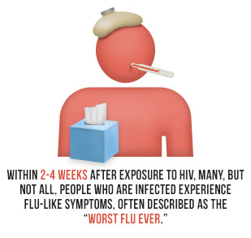
H.I.V. Symptoms
Many people infected with H.I.V. don’t show any signs or symptoms for 10+ Years!
Some individuals develop
flu like symptoms 2-3
weeks after the initial
infection

Slide 21
FIND THE FACTS GET TESTED STAY SAFE
Visit:
Center for disease control www.cdc.gov
Planned Parenthood
Norristown Health Center
Norristown
1221 Powell Street
Norristown, PA 19401
P: 610.279.6095

